Slide 1
Directions: Practice clicking and dragging the color tiles over some letters or numbers

Slide 2
Directions: Color your name with any tiles you want.

Slide 3
Directions: Color the vowels RED

Slide 4
Directions: Color the even numbers blue and the odd numbers yellow

Slide 5
Directions: Color the home row left hand red.

Slide 6
Directions: Color the home row right hand purple.

Slide 7
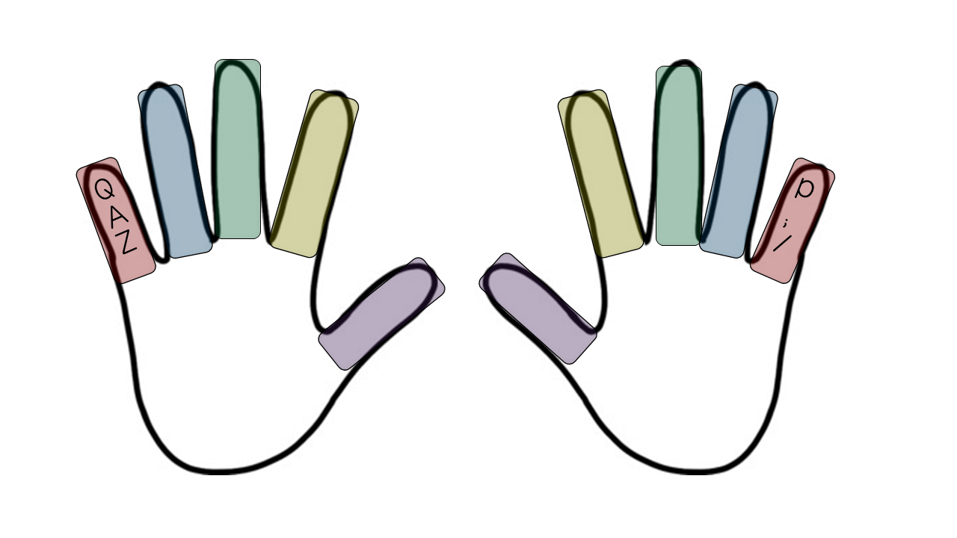
Directions: Color the left and right pinky finger letters red.

Slide 8
Directions: Color the left and right ring finger letters blue.

Slide 9
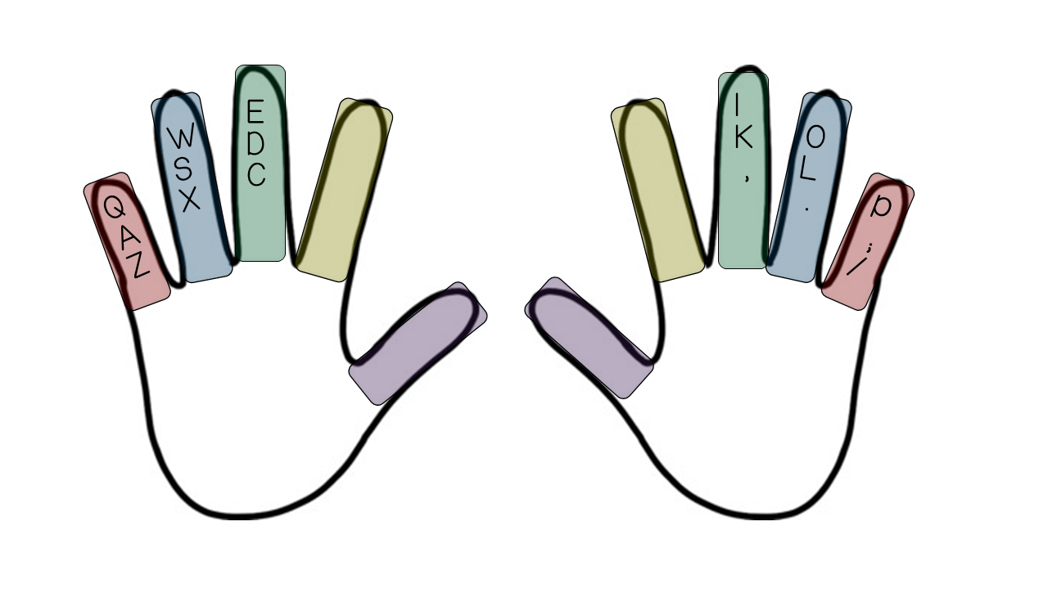
Directions: Color the left and right middle finger letters green.

Slide 10
Directions: Color the left and right pointer finger letters yellow.

Slide 11
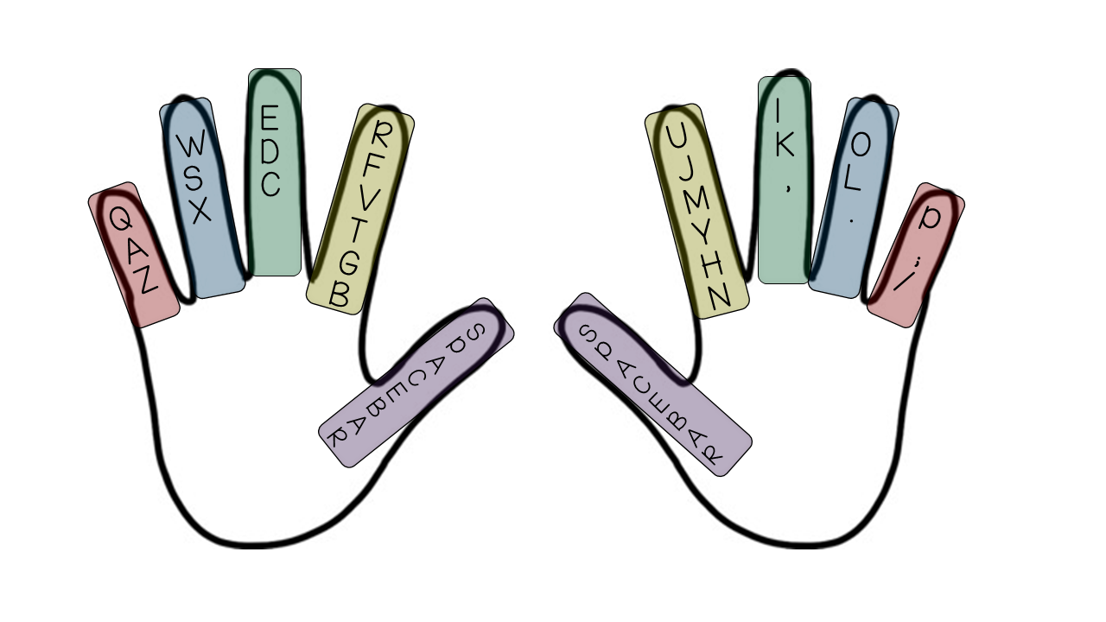
Directions: Color the space bar purple.

Slide 12
Directions: Color the whole keyboard.

